Slide 1
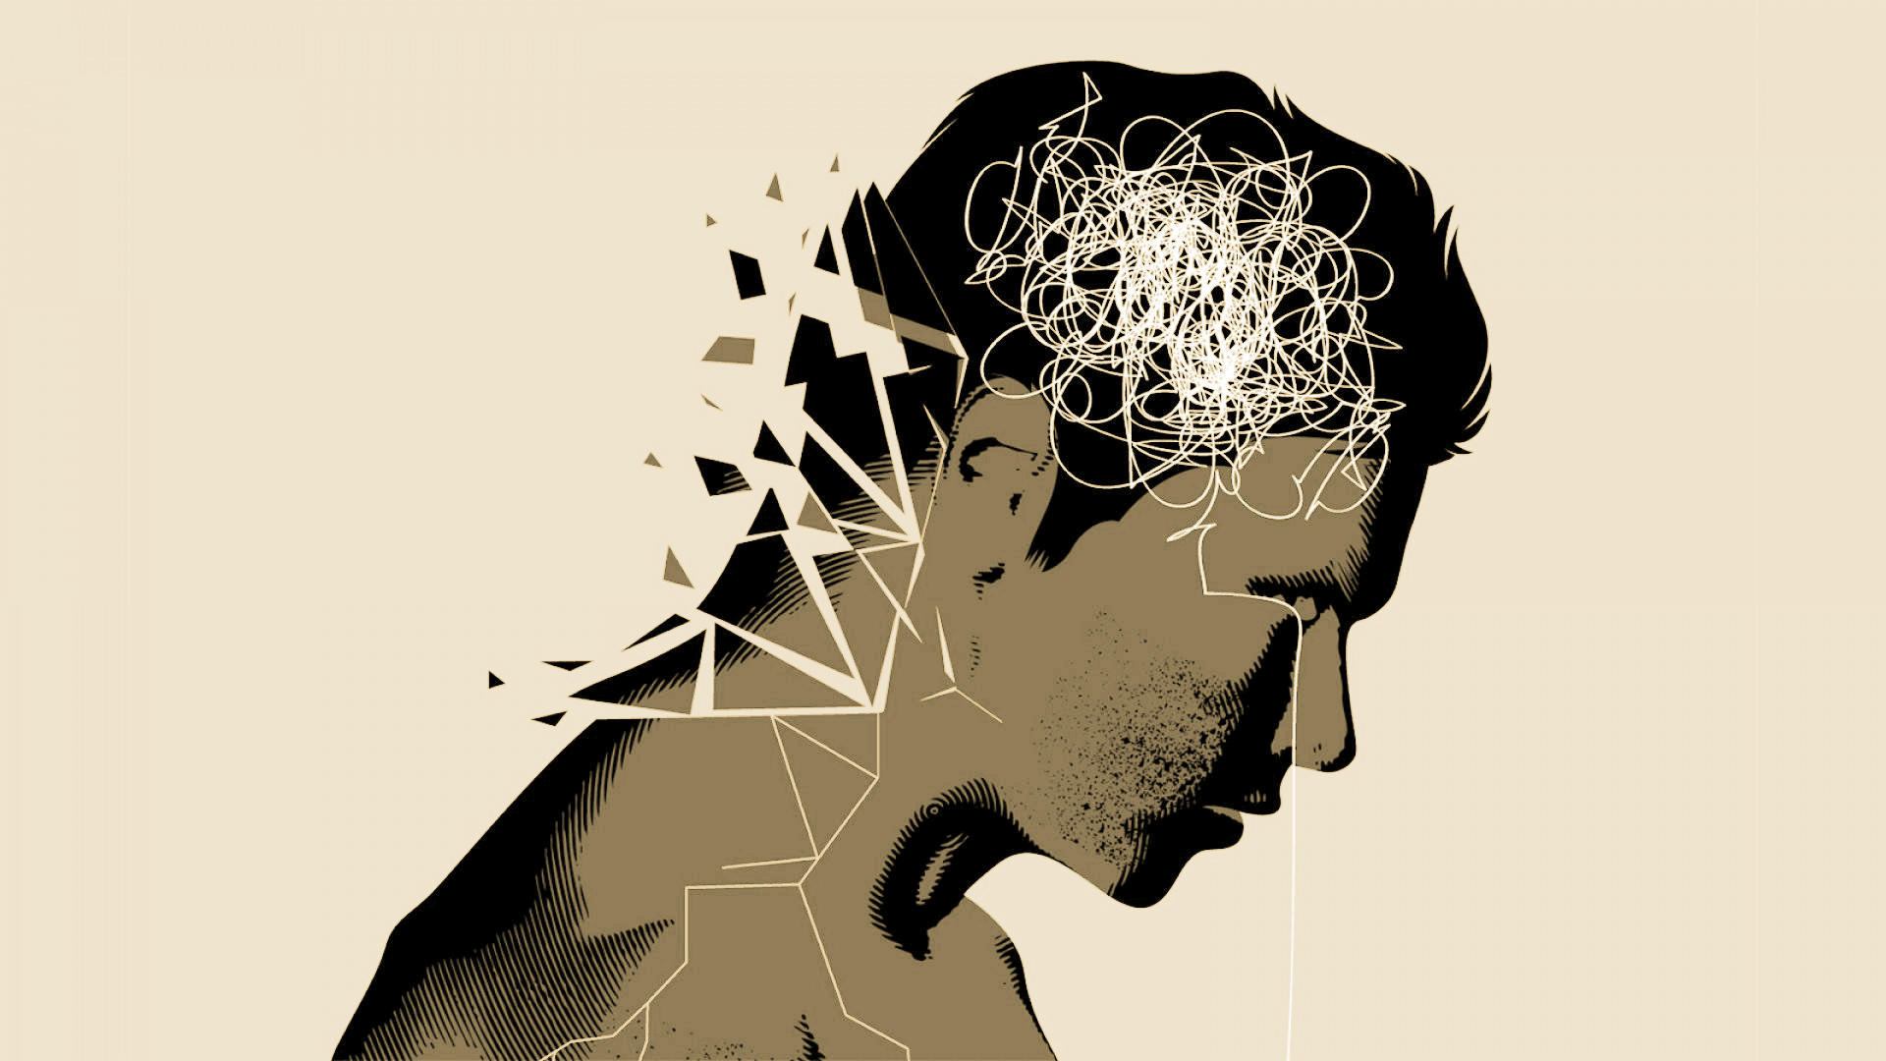
Mental Health Diagnostic Predictive Model
Brian, Alison, Will, & Raghen

Slide 2
Background

Slide 3
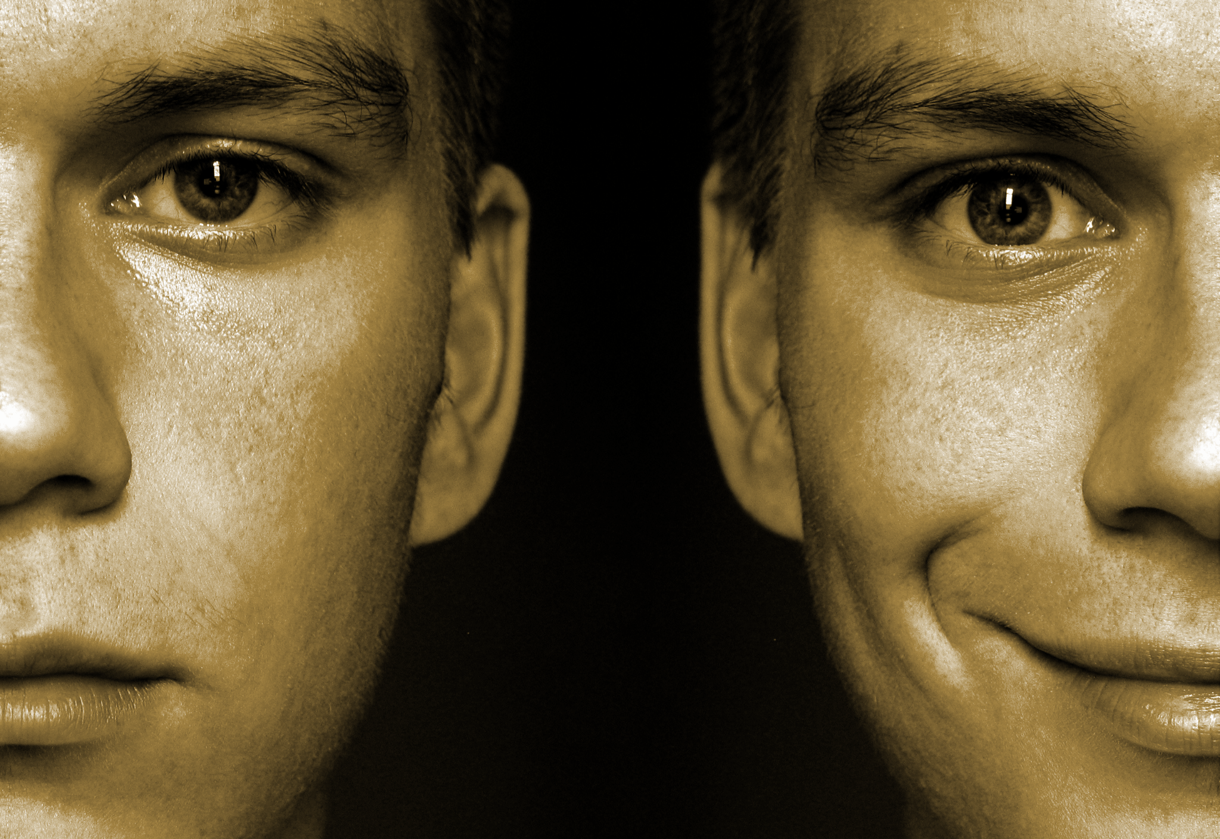
Prevalence
Based on The National Institute of Mental Health 1 in 40 people or 7.8 million people in the United States are diagnosed with Bipolar Disorder.
Diagnosis of Bipolar is based on patient self reports of symptoms.
40% or approximately 3 million people diagnosed with Bipolar Disorder are misdiagnosed

Slide 4
Bipolar 1 or Bipolar 2
Bipolar I disorder is a manic-depressive disorder that can exist both with and without psychotic episodes
Bipolar II disorder consists of depressive and manic episodes which alternate and are typically less severe and do not inhibit function

Slide 5
Diagnostic Criteria: Bipolar Mania
Inflated self-esteem or grandiosity
Decreased need for sleep
Increased talkativeness
Racing thoughts
Distracted easily
Increase in goal-directed activity or psychomotor agitation
Engaging in activities that hold the potential for painful consequences, e.g., unrestrained buying sprees

Slide 6

Diagnostic Criteria: Bipolar Depression/Depression
Depressed mood most of the day, nearly every day
Loss of interest or pleasure in all, or almost all, activities
Significant weight loss or decrease or increase in appetite
Engaging in purposeless movements, such as pacing the room
Fatigue or loss of energy
Feelings of worthlessness or guilt
Diminished ability to think or concentrate, or indecisiveness
Recurrent thoughts of death, recurrent suicidal ideation without a specific plan, or a suicide attempt

Slide 7
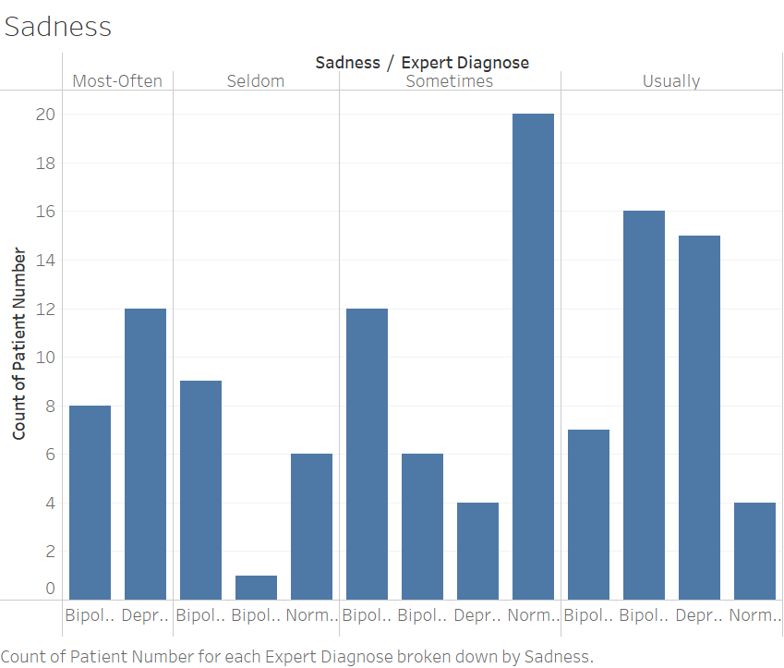

Slide 8
Our Data Set

Slide 9
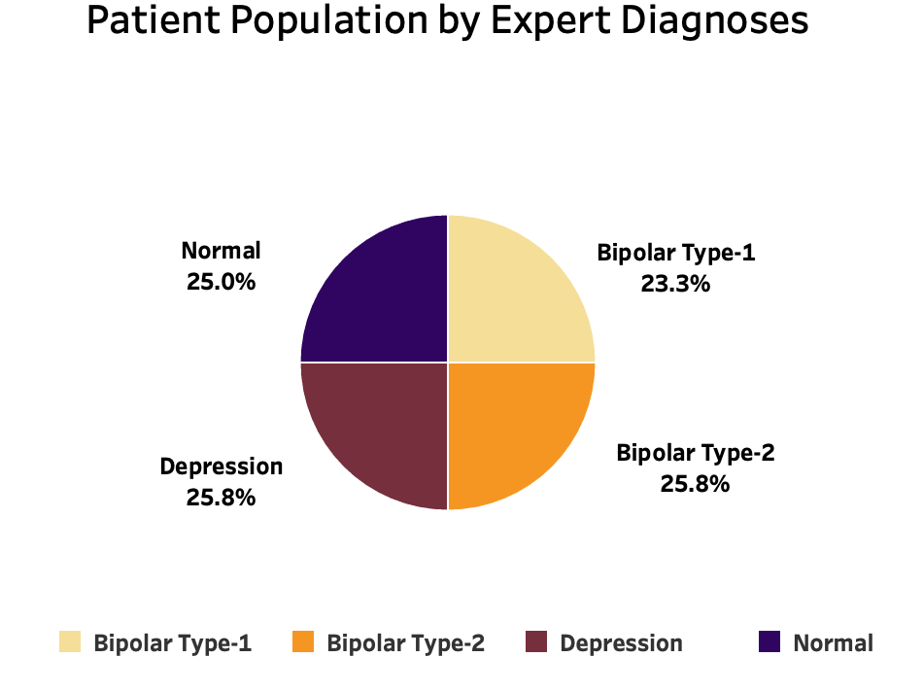
Mental Disorder Classification Data
About the data:
Collection of 120 Psychology Patients with 17 Essential Symptoms to Diagnose Mania Bipolar Disorder, Depressive Bipolar Disorder, Major Depressive Disorder, and Normal Individuals.
17 essential symptoms psychiatrists use to diagnose the described disorders.
The Normal category refers to the individuals using therapy time for specialized counseling, personal development, and life skill enrichments. While such individuals may also have minor mental problems, they differ from those suffering from Major Depressive Disorder and Bipolar Disorder.
Source- Kaggle: https://www.kaggle.com/datasets/cid007/mental-disorder-classification

Slide 10
Model & Results

Slide 11
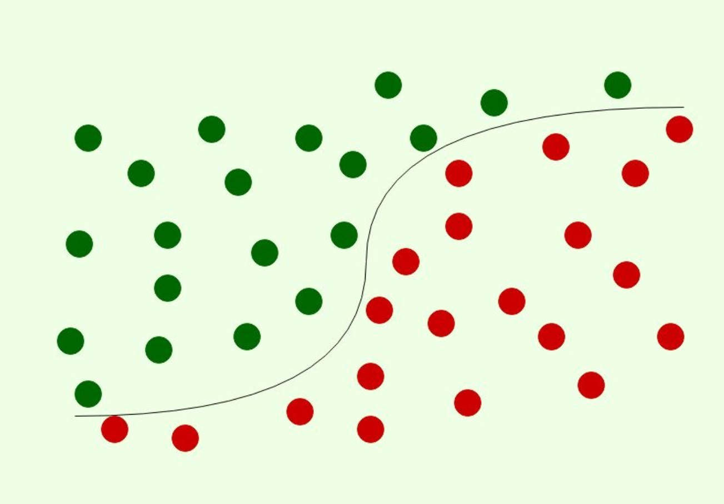
Predicting Bi Polar Type 1 & 2
Our Model:
Supervised Learning
Binary Logistic Regression
Classification Model
We ran the model 2 times for Bi-Polar
The 1st run we used all 17 features
Coefficient analysis to filter out the least important features
The 2nd run of the model, we only used the top 5 most important features determined via the coefficient analysis
Run #1- Features:
Mood Swings
Nervous Breakdown
Aggressive Response
Suicidal thoughts
Euphoric
Ignore & Move on
Concentration
Sleep Disorder
Optimism
Try-Explanation
Authority Respect
Admit Mistakes
Sadness
Exhausted
Anorexia
Sexual Activity
Overthinking
Run #2- Features:
Mood Swings
Nervous Breakdown
Aggressive Response
Suicidal thoughts
Euphoric
Yes
No

Slide 12
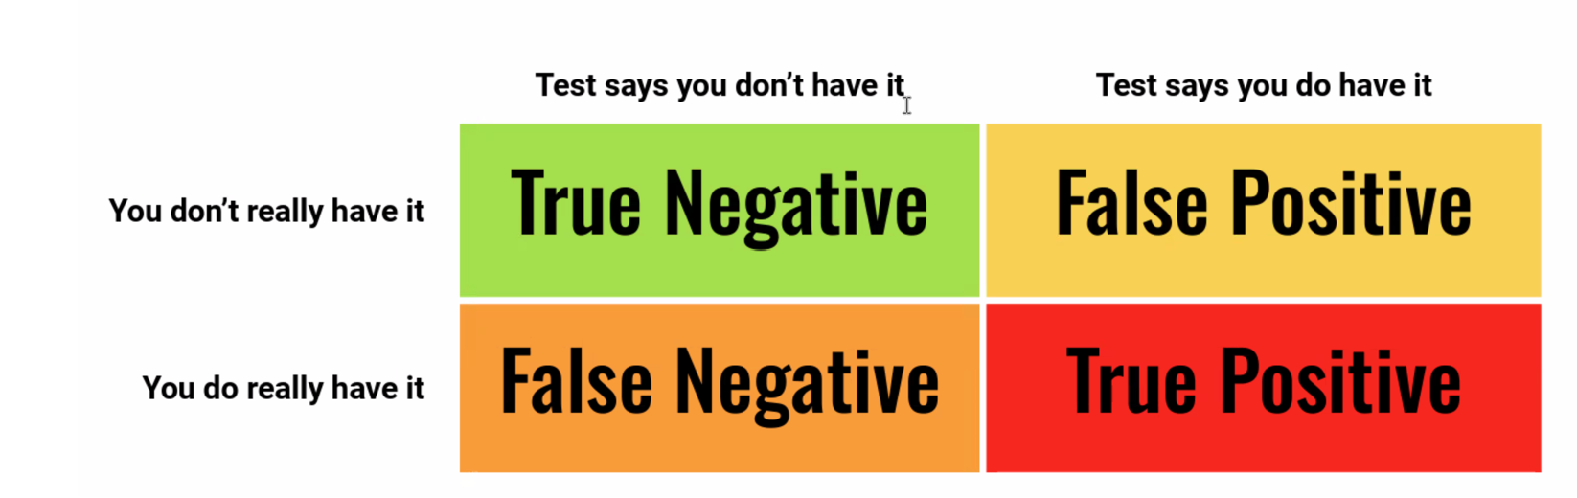
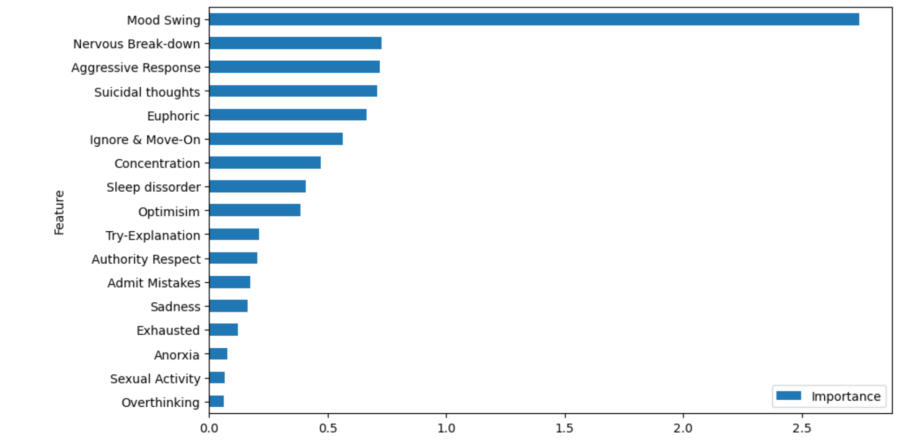
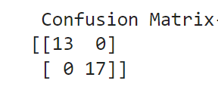
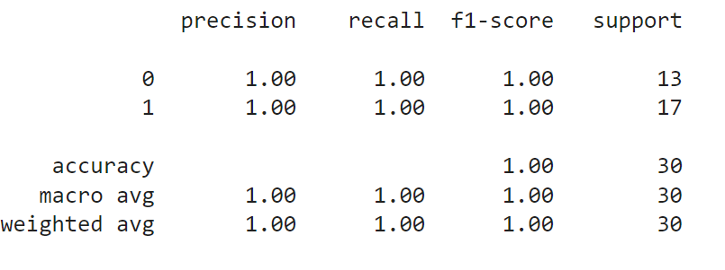
Results: Bi-Polar Prediction Run #1 & #2 returned 100% Accuracy in Predicting Bi-Polar Disorders!
Model Results:
Coefficient Analysis :

Slide 13
Predicting Depression
Binary Logistic Regression and scaled the data
We ran the model 2 times
The 1st run we used all 17 features
Coefficient analysis to filter out the least important features
The 2nd run of the model, we only used the top 5 most important features determined via the coefficient analysis
Run #1- Features:
Mood Swings
Nervous Breakdown
Aggressive Response
Suicidal thoughts
Euphoric
Ignore & Move on
Concentration
Sleep Disorder
Optimism
Try-Explanation
Authority Respect
Admit Mistakes
Sadness
Exhausted
Anorexia
Sexual Activity
Overthinking
Run #2- Features:
Sadness
Euphoric
Mood Swings
Overthinking
Optimism

Slide 14
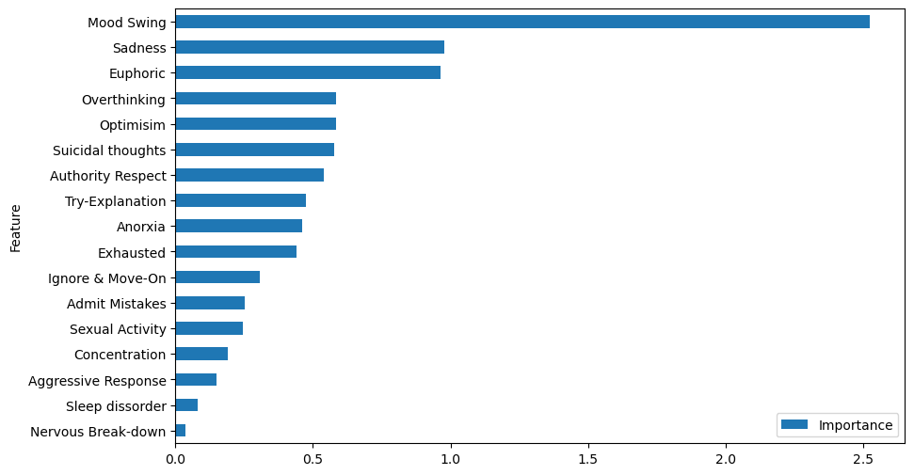
Coefficient Analysis for Depression

Slide 15
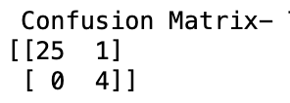
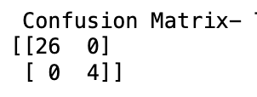
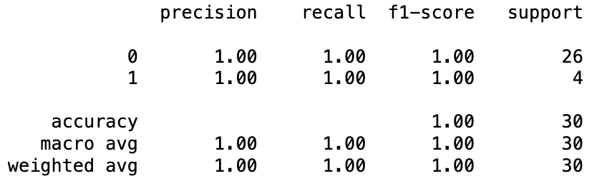
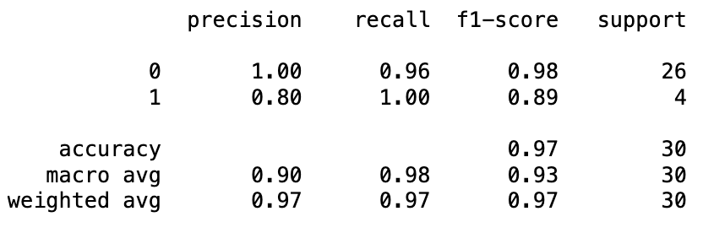
Results: Depression Prediction
Model 1 Returned 97% Accuracy
Model 2 Returned 100% Accuracy

Slide 16
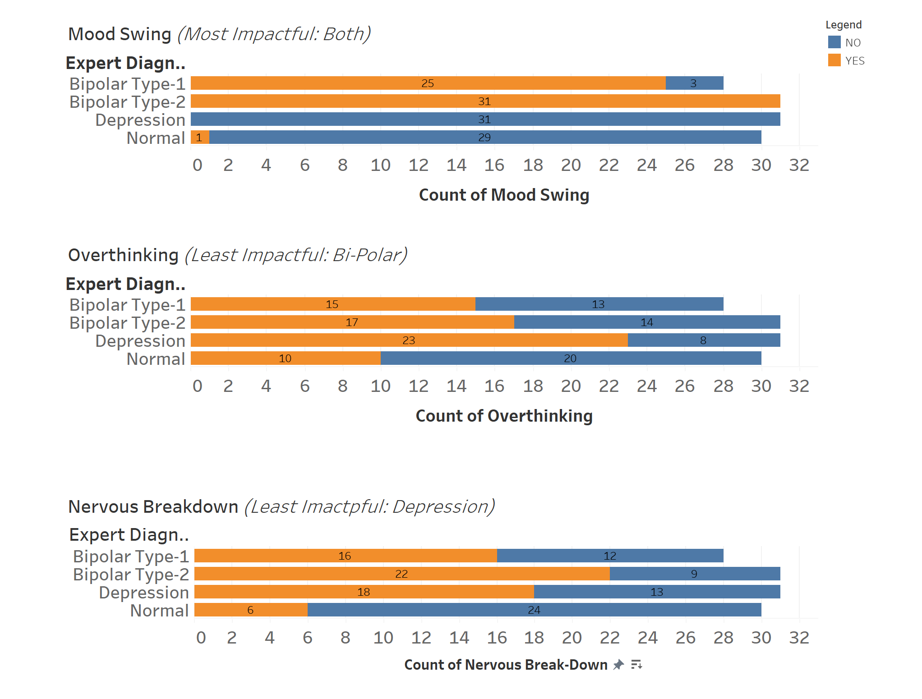
Additional Insights on Coefficient Analysis

Slide 17
Next Steps

Slide 18
Future Analysis Options
Run a larger data set through the models- this data set only has 120 patients
Use a Multinomial Logistic Regression to predict multiple categories

Slide 19
Thank You!

Slide 20
References
Bipolar Disorder
https://www.nimh.nih.gov/health/statistics/bipolar-disorder
American Psychiatric Association. (2013). Diagnostic and statistical manual of mental disorders (5th ed.).
Data Source- Kaggle: https://www.kaggle.com/datasets/cid007/mental-disorder-classification

